Slide 1
EMMA WATSON
By Isabella Barker

Slide 2
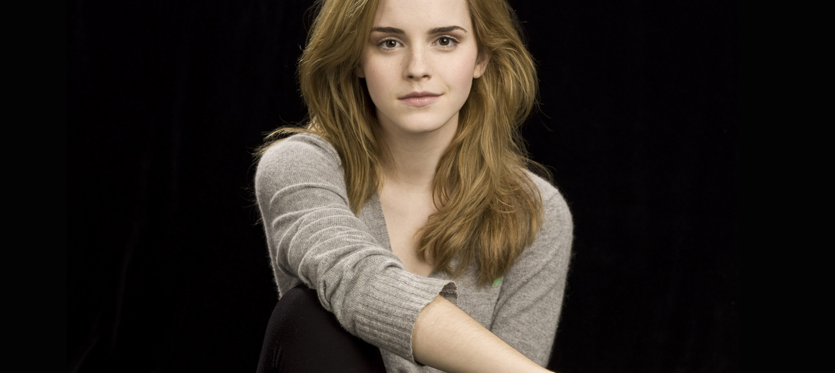
Emma Watson was born on the 15 of April 1990 and went to dragon school.

Slide 3
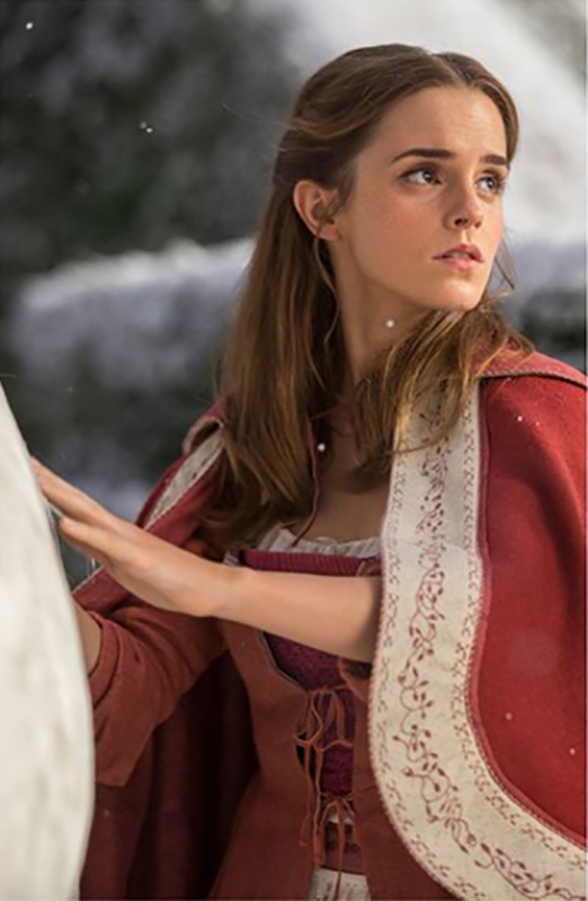
What she does
She went to brown university . She is a Actress, model and activist.

Slide 4
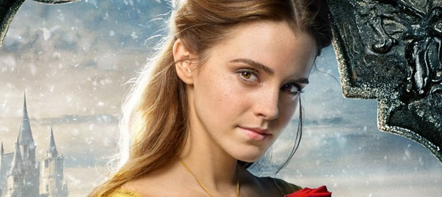
WHAT MOIVES EMMA WATSON DID.
She did eight harry potter films and starred as belle.

Slide 5
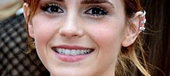

Slide 6


